Slide 1
Automatic Generation of Ontology Editors
Henrik Eriksson
Department of Computer and Information Science
Linkoping University
SE-581 83 Linkoping, Sweden
Raymond W. Fergerson Yuval Shahar Stanford Medical Informatics
Stanford University
Stanford, California 94305-5479, U.S.A.

Slide 2
Knowledge Engineering (KE)
KE is “an engineering discipline that involves integrating knowledge into computer systems in order to solve complex problems normally requiring a high level of human expertise.”
Metatools can support KE by assisting developers in the design and implementation of domain-oriented knowledge-acquisition tools
use ontologies as a basis for automatic generation of knowledge acquisition tools
[Feigenbaum 1983]

Slide 3
Metatools
Metatools generate domain-specific knowledge-acquisition tools
generation of tools that acquire instances and rules
necessary to involve domain experts
Existing metatools separate ontology definition and instance editing
knowledge engineer maintain classes
domain experts specify instances

Slide 4
Problems of Separation of Ontology Definition and Instance Editing
Domain experts are only able to add and edit domain instances, not domain-specific classes
Knowledge engineer needs to maintain classes by working with experts
Distinction between ontology editing and editing of knowledge bases
limited the support for acquisition of classes

Slide 5
Background of PROTÉGÉ
PROTÉGÉ consists of a set of tools:
developer creates a domain ontology
developer selects a problem-solving method for application tasks
developers uses the ontology as the basis for generating a knowledge-acquisition tool
domain specialists can then use this knowledge-acquisition tool to create knowledge bases,

Slide 6
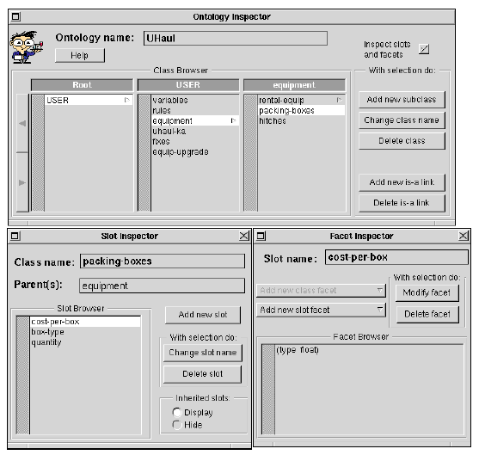
Example Ontology Editor

Slide 7
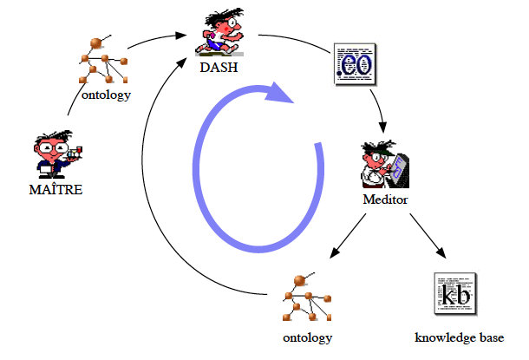
Generation of Knowledge-acquisition Tools and Ontology Editors

Slide 8
New Approach: Generation of Ontology Editor
Ontology acquisition
specify metalevel aspects of the input ontology (i.e., class and slot metaclasses)
generate automatically knowledge-acquisition tools that support ontology editing
Support the editing of both classes and instances in a single tool
Contain several ontology editors that operate on different subontologies (i.e., different class subtrees)

Slide 9
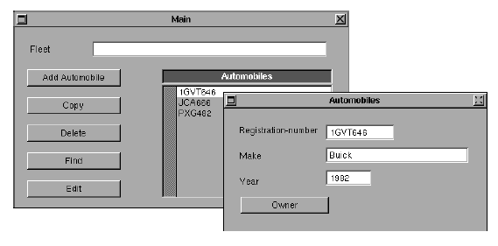
Ontologies in PROTÉGÉ-II
Class, Slot, Facet:

Slide 10
Ontology Annotations: Facets for Knowledge Acquisition
Generation of knowledge-acquisition tools from ontologies sometimes requires additional information about slots
Developers can use the ka-specification slot facet to provide this information.

Slide 11
Example of Facet for Knowledge Acquisition
the slot registration-number
ka-specification facet
browser-key

Slide 12
Metaclasses
Metaclasses are specification classes (i.e., they model class properties rather than object properties).
Metaclass definition includes slots:
class name
superclasses
subclasses
list of slots
additional class features.

Slide 13
Metaslots
Metaslots are specifications of the slots used and their properties (facets).
slot name
slot type
default value
…

Slide 14
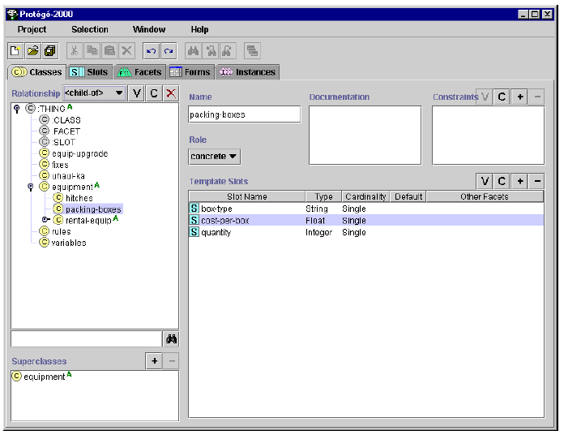
Tree Editor
User interface widgets that support ontology editing

Slide 15
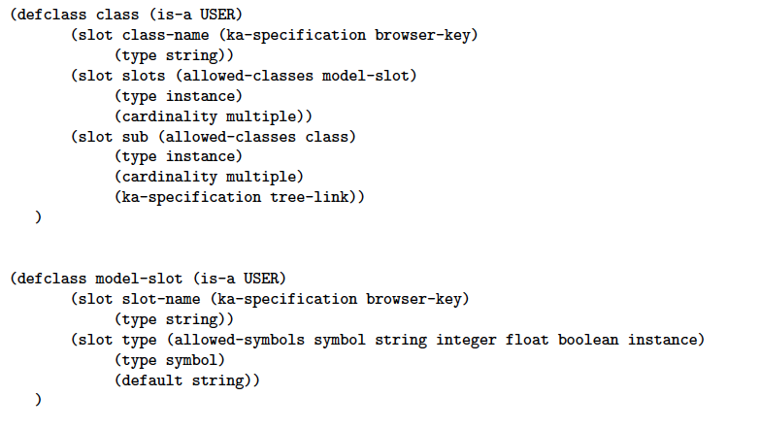
Ontology Specification - PROTÉGÉ-II Specification

Slide 16
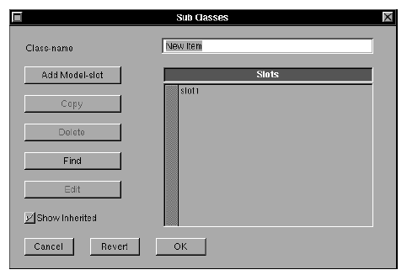
PROTÉGÉ-II Class Editor

Slide 17
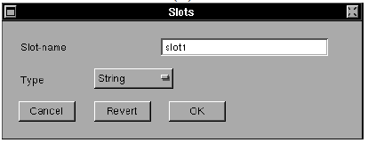
PROTÉGÉ-II Slot Editor

Slide 18
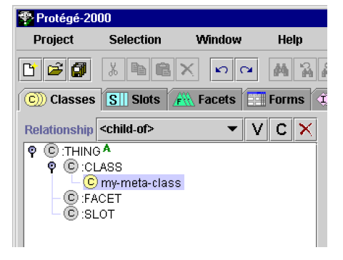
Ontology Specification - PROTÉGÉ-2000
Developers create new metaclasses by subclassing :CLASS.

Slide 19
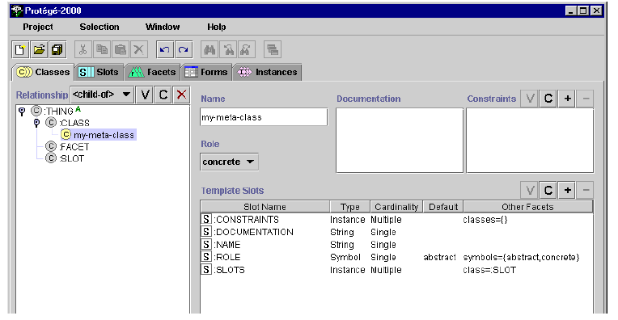
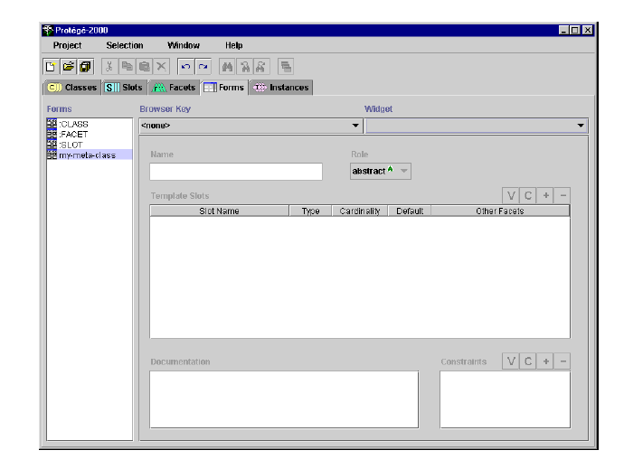
Custom Adjustment of Form

Slide 20
Summary of PROTÉGÉ approach
Provide a flexible mechanism for the specification of ontology, class, and slot editors.
Extend the set of class and slot facets supported by adding new slots to the metaclass and metaslot definitions
Support custom tailor form layout [Eriksson et al., 1994]

